Slide 1
Rated Ladder
By Matt Mahowald

Slide 2
The Rated Ladder Program
The rated Ladder program assists a coach in administrative details for a chess club.
  Source code available under the GPL
  Software is FREE, and GPL makes sure it stays that way
Labels clearly show information necessary for club
  First Name is displayed prominently
Students enter their own games
  Labels show rank which allows easy input into program
Group Letters are used to help sort the students into groups of skill.
  Lessons are much more effective when students are at similar levels
  Players are allowed to play one letter different.
    For example, C’s may play B’s or D’s
  Students can choose their own pairings.
Program assists in taking attendance.
System is compatible with USB Flash drives (no install necessary) for easy use

Slide 3
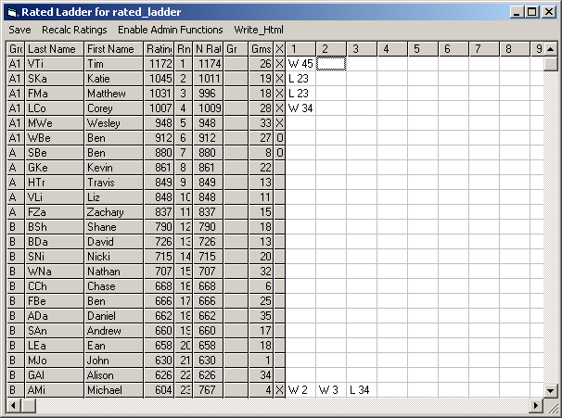
Rated Ladder
(Player Mode)

Slide 4
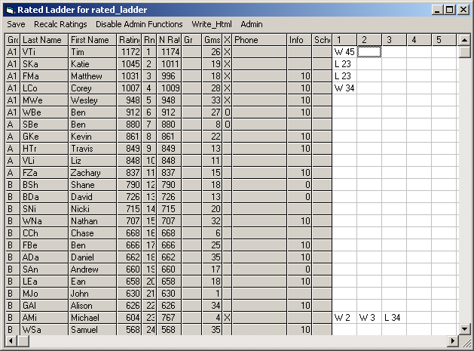
Rated Ladder
(Admin Mode)

Slide 5
Entering Games
Players may only play each other once per day.
  Program enforces rule
Its only necessary to enter one players result
  The other players result is automatically entered
Single game Entry 23W21
Double game entry 23WW21
Bughouse Double game entry 23:23WW21:21
Allows adding of players outside admin mode.
  If a game includes an empty player, a dialog box appears allowing the player to be entered in at that time.
Verifies entries on demand
  Saves current work

Slide 6
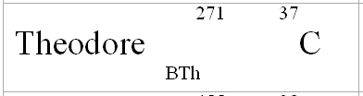
Admin Mode
Ratings may be shown or hidden
  Labels follow same rule
Displays Contact phone numbers
  Assists in calling home for late students.
Can contain typical club data, such as payments etc.
  Some clubs use it for all club information
Labels are printed directly from program, or by using MS Word’s Mail Merge
  Uses Avery 5161, 20 Labels/Sheet

Slide 7
Using Rated Ladder during club
The labels are passed out as the students enter the room.
  The labels can be used to take attendance.
Students are not to sit down unless they are playing a game.
  This reduces bullying and other club problems.
They know who they may play because of the letters on their name tags.
  Student can play +/- one letter.
Labels are collected as the students leave.
  Keeps track of students

Slide 8
Weekly Administration
Run the program in Admin mode.
  Select Menu item <Enable Admin Functions>
  There is a settable password in ladder.ini or using setup menu item
Sort players by new rating
  Select Menu item <Admin><Rerank all players>
  This allows viewing of what will happen when all the games are rated.
  Change players group according to their performance
  Function keys F1-F6 can quickly change players Group
Setup for new day
  Select Menu item <Admin><New Day>
Print Labels
  Select Menu item <Admin><Print Labels>

Slide 9
The Elo Rating System
The Rated Ladder uses the system developed by Professor Arpad Elo
  S is result of game, 1 for win, ½ for draw, 0 for Loss
  Ea is expected result
  K is the Points gained or lost with a win against an equal player.
Rated Ladder differences
  If an opponent has less than 10 games, then Rating is ½ K
  If a player has less than 20 games, than the player is rated by averaging opponents.
  If a player has less than 10 games, rating is approximately the average of the game performance.
    Game performance is opponent rating +400 if the player won
    Game performance is opponent rating -400 if the player lost
    Game performance is opponent rating if the game was a draw
1
Ea =
1 + 10
Rb –Ra
400
R = R + (Ea*2 – S )*K

Slide 10
Settings Menu
K Factor
  Sets the value that each game is worth
Num Of Rows
  Needs to be a multiple of 20
Show School
  Shows the school on the label
Show Ratings
  Shows the Ratings on the Label
Print Room
  Show Room number on labels
Password
Place Trophies
  The Ladder program will write out the trophies that each player wins. The basic rule is that a player is only eligible for one trophy.
Coach1
  For the player reports
Print Offset
  For printing on poorly aligned printers
Print Zoom
  Allows the labels to be shrunk to fit on miss aligned printers.

Slide 11
Contact Information
Program Developed in Visual Basic 6.0 by Matt Mahowald
Web site:
  Qmerge.no-ip.info
E-Mail
  Qmerge@hotmail.com

Slide 12
Web Sites
Description of Chess Rating
  http://math.bu.edu/people/mg/ratings/approx/approx.html
Source code (and updates) for rated ladder
  https://sourceforge.net/projects/rated-ladder

Slide 13
Bughouse
Long entry
  (3) :5w6:8
  (5) :3w6:8
  Widen fields
  W=w/1 game
  L=l/1 game
  D=d/1g
  Wd=1.5 of 2
Quick Entry
  3:5w6:8
  Sort by Player Number
Opponents array
Partners Array
  Dynamically figure out
  Match is a hash of partners
  100 players means 10000 hash hits
  100x100 vs 100x100
  Does not seem to work well
Game list
  No rule about same player twice
    Do a string search for same player
  Visual entries are fake
    Ignore locked cells
  Quick entry is method of keeping data
  Editing facilitated by keeping record of which game caused the entry.

Slide 14
Networking
Set Pc as “Master” or slave1 or slave2
  Master has fixed IP (127.0.0.1)
    Set by config file
    Different config file for bughouse?
  Slaves don’t
  s1- 29489
  s2- 29490

